Slide 1



Currency Breakdown Calculator
Created under the Guidance of Dr. Venkat Isampalli Sir
INTRODUCTION
Roll Number | Name | Role
2520030446 | K. Satwik | Project Lead
2520080007 | B. Harshitha | Algorithm & Calculator Implementation
2520030558 | V. Rohan | Core Java Developer
2520030588 | M. Shravya | Integration
2520030589 | B. Niharika | Input Validation & Error Handling
2520030440 | K. Anshu | Testing & Quality Assurance
25UC0034 - GLOBAL LOGIC BUILDING CONTEST PRACTICUM

Slide 2
Abstract {
01
02
03
Currency Breakdown Calculator
Section – 9, Team - G
Objective
To build a robust and highly efficient software tool capable of calculating the precise breakdown of any amount into the minimum required set of currency notes.
Scope
The project transforms a basic procedural calculation into a modular, Object-Oriented system using Java. The final scope includes advanced features like good data handling, robust error prevention, and flexible integration with external interfaces.
Key Outcomes
The system features clean code separation (logic vs. data), supports polymorphic currency types for easy expansion, and incorporates elements well for dynamic result storage, all validated through a functional web interface.
}
25UC0034 - GLOBAL LOGIC BUILDING CONTEST PRACTICUM

Slide 3
Problem Statement:
Simple Java Project on Currency Breakdown Calculator
Section – 9, Team - G
The problem statement is to efficiently solve the change-making algorithmic problem for currency. Any system handling cash transactions (ATMs, vending machines, etc…) must accurately and quickly calculate the minimum number of notes required to break down a given amount.
Importance: This optimization is crucial for cost efficiency in real-world systems, ensuring fewer physical resources are used and transactions are fast.
Gaps in Simple Solutions: Simple, procedural solutions suffer from three major gaps:
Lack of Scalability: They are hardcoded for a single currency and must be completely rewritten to add new denominations (like a new note value).
Lack of Flexibility: They cannot easily be adapted to different currency systems (e.g., USD denominations) or user requirements.
Low Robustness: They lack essential error handling for invalid inputs (text, negative numbers), making the application prone to crashes.
25UC0034 - GLOBAL LOGIC BUILDING CONTEST PRACTICUM

Slide 4
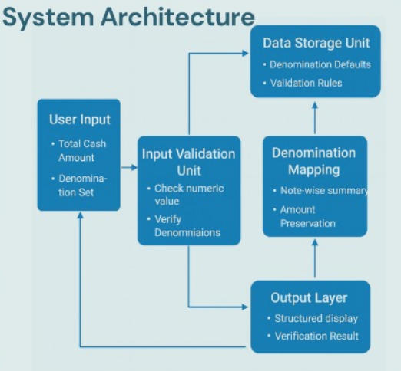
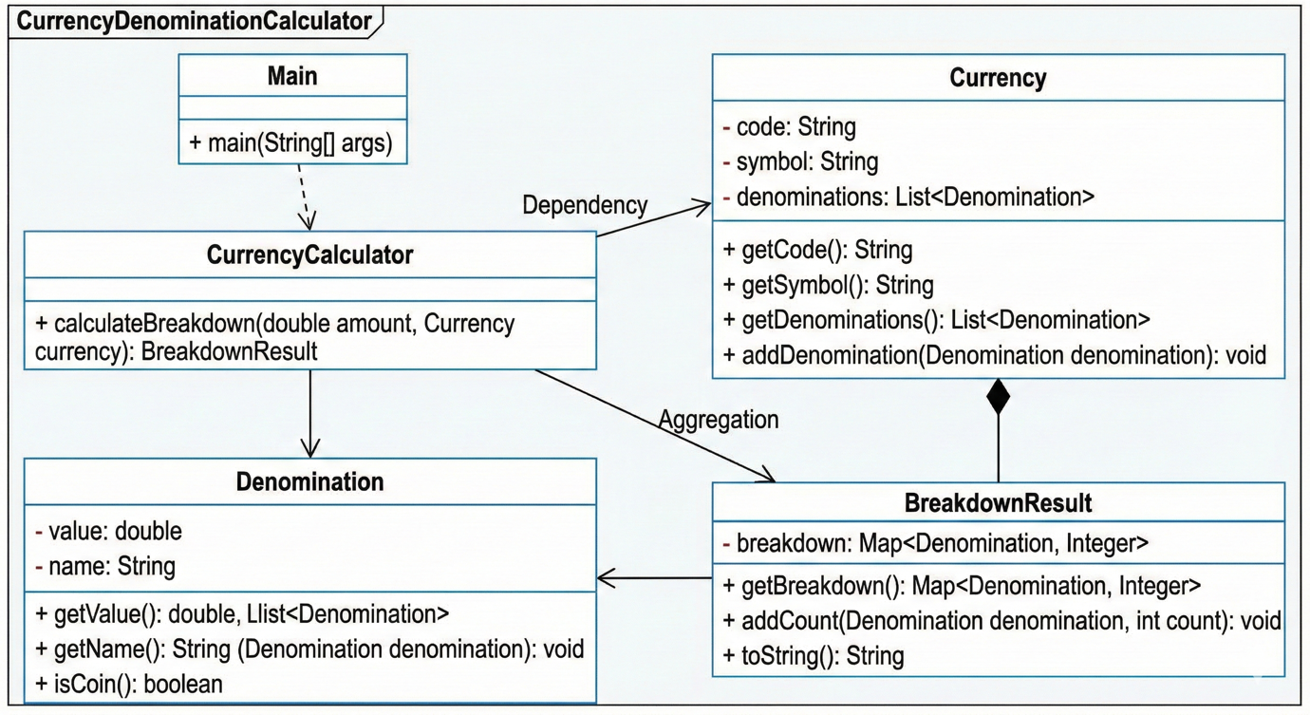
Our Proposed System {
Currency Breakdown Calculator
Section – 9, Team – G
Architectural Diagram
Class Diagram
}
25UC0034 - GLOBAL LOGIC BUILDING CONTEST PRACTICUM

Slide 5
Technology / Tools used {
Currency Breakdown Calculator
Section – 9, Team - G
Category | Tools used | Reason for Usage
Backend/Core Logic | Java (JDK) | Primary language for implementing OOP principles & logic.
Frontend/Interface | HTML, CSS, JavaScript | Used to create a functional, modern web interface for user interaction and output display.
Integrated Development Environment | Visual Studio Code | Used for writing and debugging the Java core logic and for authoring the HTML, CSS, and JavaScript files for the web interface.
}
25UC0034 - GLOBAL LOGIC BUILDING CONTEST PRACTICUM

Slide 6
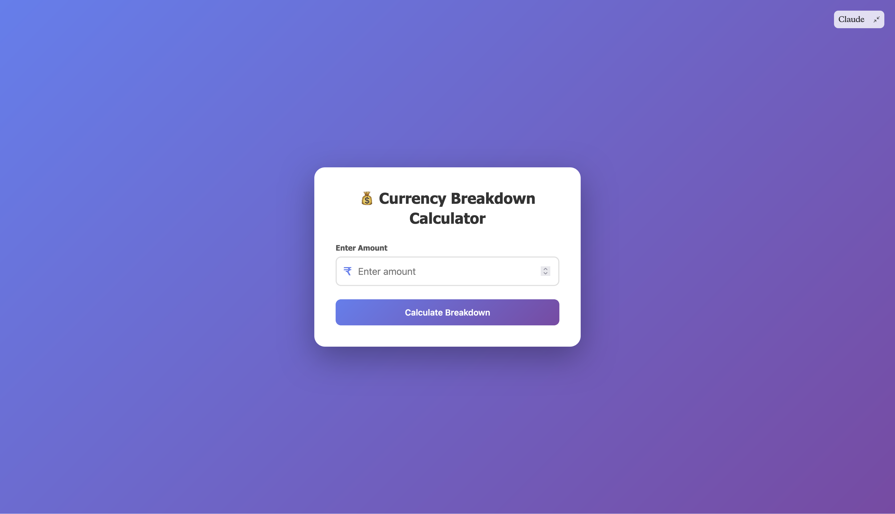
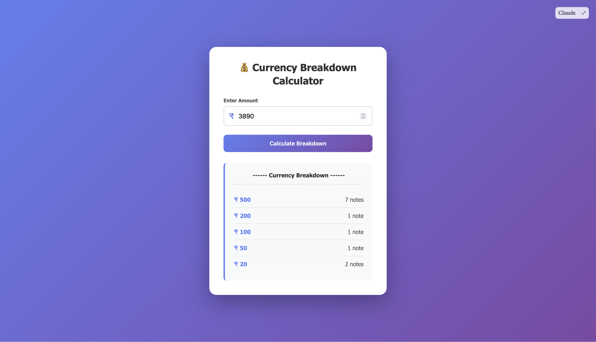
Screenshots of our Project { Link to our Project website
Currency Breakdown Calculator
Section – 9, Team - G
Screenshot of Project Website
Example Test Case
}
25UC0034 - GLOBAL LOGIC BUILDING CONTEST PRACTICUM

Slide 7
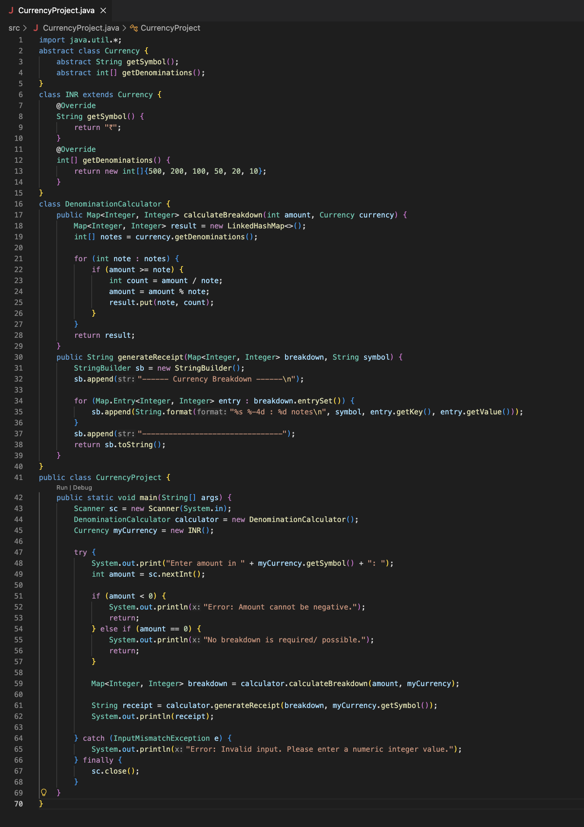
Screenshot of the Code {
Currency Breakdown Calculator
Section – 9, Team – G
}
25UC0034 - GLOBAL LOGIC BUILDING CONTEST PRACTICUM

Slide 8
Test Cases For Our Project {
Currency Breakdown Calculator
Section – 9, Team - G
Intent of Test Case | Input Amount | Expected Output | Actual Output
Full Breakdown | ₹ 3890 | ₹ 500 : 7 notes, ₹ 200 : 1 notes, ₹ 100 : 1 notes, ₹50 : 1 notes, ₹ 20 : 2 notes | ₹ 500 : 7 notes, ₹ 200 : 1 notes, ₹ 100 : 1 notes, ₹50 : 1 notes, ₹ 20 : 2 notes
Zero Remainder | ₹ 1000 | ₹ 500 : 2 notes | ₹ 500 : 2 notes
Unaccounted Remainder | ₹ 333 | ₹ 200 : 1 notes, ₹ 100 : 1 notes, ₹ 20 : 2 notes, ₹ 10 : 1 notes Unaccounted balance : ₹ 3 | ₹ 200 : 1 notes, ₹ 100 : 1 notes, ₹ 20 : 2 notes, ₹ 10 : 1 notes Unaccounted balance : ₹ 3
Edge Case (Invalid Input) | ABC | Please enter a valid, non-negative integer amount. | Please enter a valid, non-negative integer amount.
Edge Case (Amount Zero) | ₹ 0 | No breakdown required (amount is zero). | No breakdown required (amount is zero).
}
25UC0034 - GLOBAL LOGIC BUILDING CONTEST PRACTICUM

Slide 9
Conclusion:
Currency Breakdown Calculator
Section – 9, Team - G
Summary: The project successfully transformed a basic task into a modular, Object-Oriented software system. The key finding is that by applying Inheritance and Encapsulation, the solution became dramatically more flexible and scalable than the initial procedural approach. The application delivers a fast calculation proving the robustness of the code.
Limitations: The calculation works correctly for standard Indian currency denominations but may not give accurate results if unusual or non-standard denominations are used.
Future Scope:
Configuration File: Load currency denominations from an external file so they can be changed easily without modifying or recompiling the program.
Advanced Algorithm: Use a more flexible calculation approach to ensure correct results even if different or unusual currency denominations are used.
Custom Exceptions: Introduce a custom Exception class to handle invalid user input more professionally.
25UC0034 - GLOBAL LOGIC BUILDING CONTEST PRACTICUM

Slide 10
This project helped us grasp practical application of Java concepts and object-oriented design principles. We Sincerely Thank our Guides Dr. Venkat Isampalli Sir for their continuous support and guidance throughout this project.
Currency Breakdown Calculator
Section – 9, Team - G
Appreciation & Acknowledgment
25UC0034 - GLOBAL LOGIC BUILDING CONTEST PRACTICUM

